Slide 1


Team 50: Remote Biometric System
Bi-Weekly Update 5 Simon Becker
Andrew-Joseph Nicolas
Lance Pagaduan
Harin Sankar Sponsor: Dr. Steven Wright TA: Hailey Ward
Notes:
Michelle

Slide 2
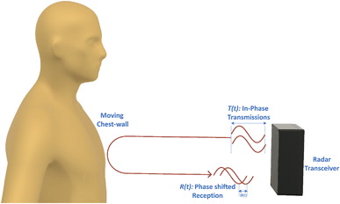
Contactless Cardiac Gating
Extensive and uncomfortable prep can be necessary
MRI Patient throughput can be improved
32% of patients think they wait too long for MRIs¹
Vasireddy, Rakesh & Roth, Corinne & Mathis, Johannes & Goette, Josef & Jacomet, Marcel & Vogt, Andreas. (2018). K-band Doppler radar for contact-less overnight sleep marker assessment: a pilot validation study. Journal of Clinical Monitoring and Computing. 32. 10.1007/s10877-017-0060-9.
Dostál, M., Jurasová, K., Keřkovský, M. et al. What factors affect a patient’s subjective perception of MRI examination. Sci Rep 14, 22731 (2024). https://doi.org/10.1038/s41598-024-74231-9
Notes:
Kyle

Slide 3
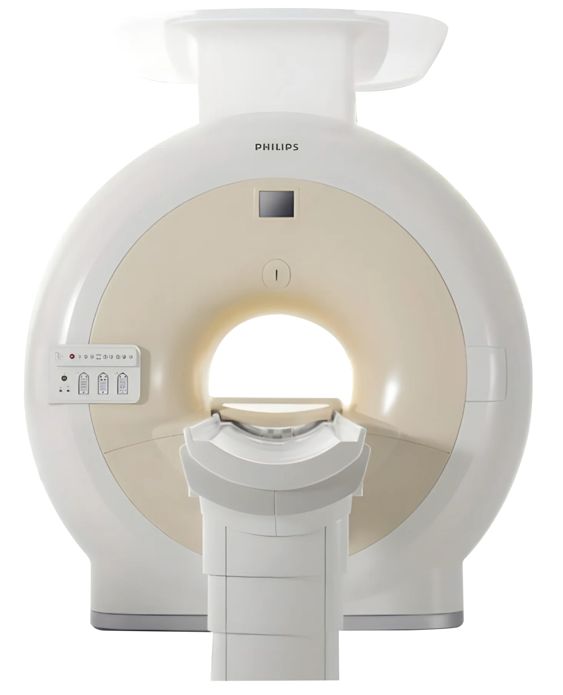

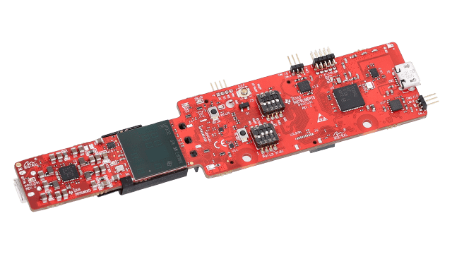
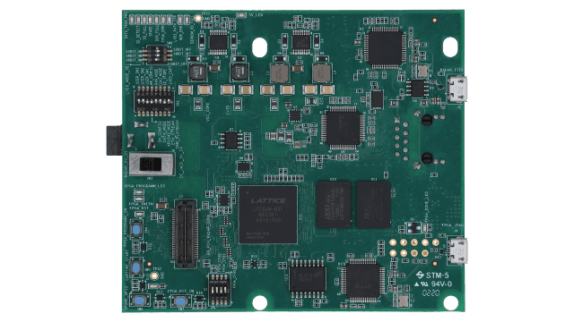
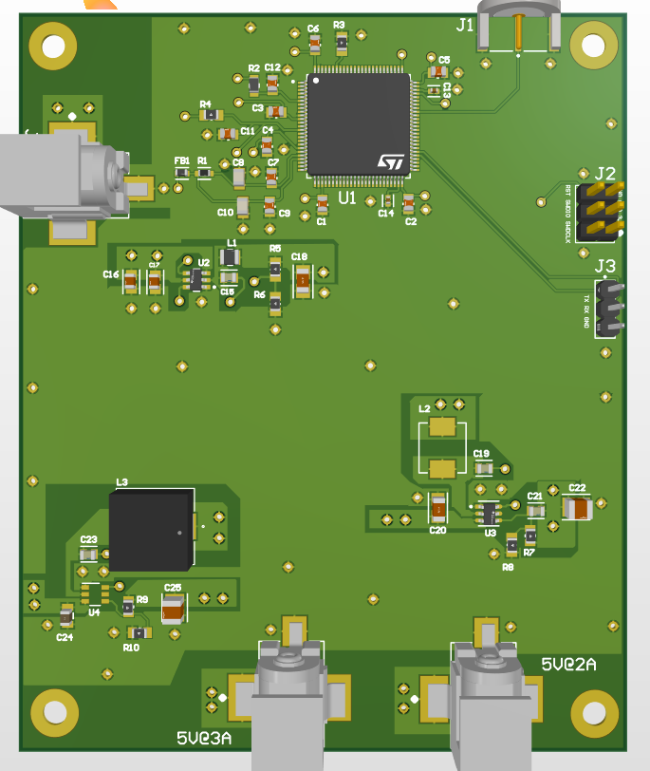
Integrated System Diagram
Hardware
Patient MRI Data
Software
Radar
Cardiac Data
PCB
Data Capture Board

Slide 4
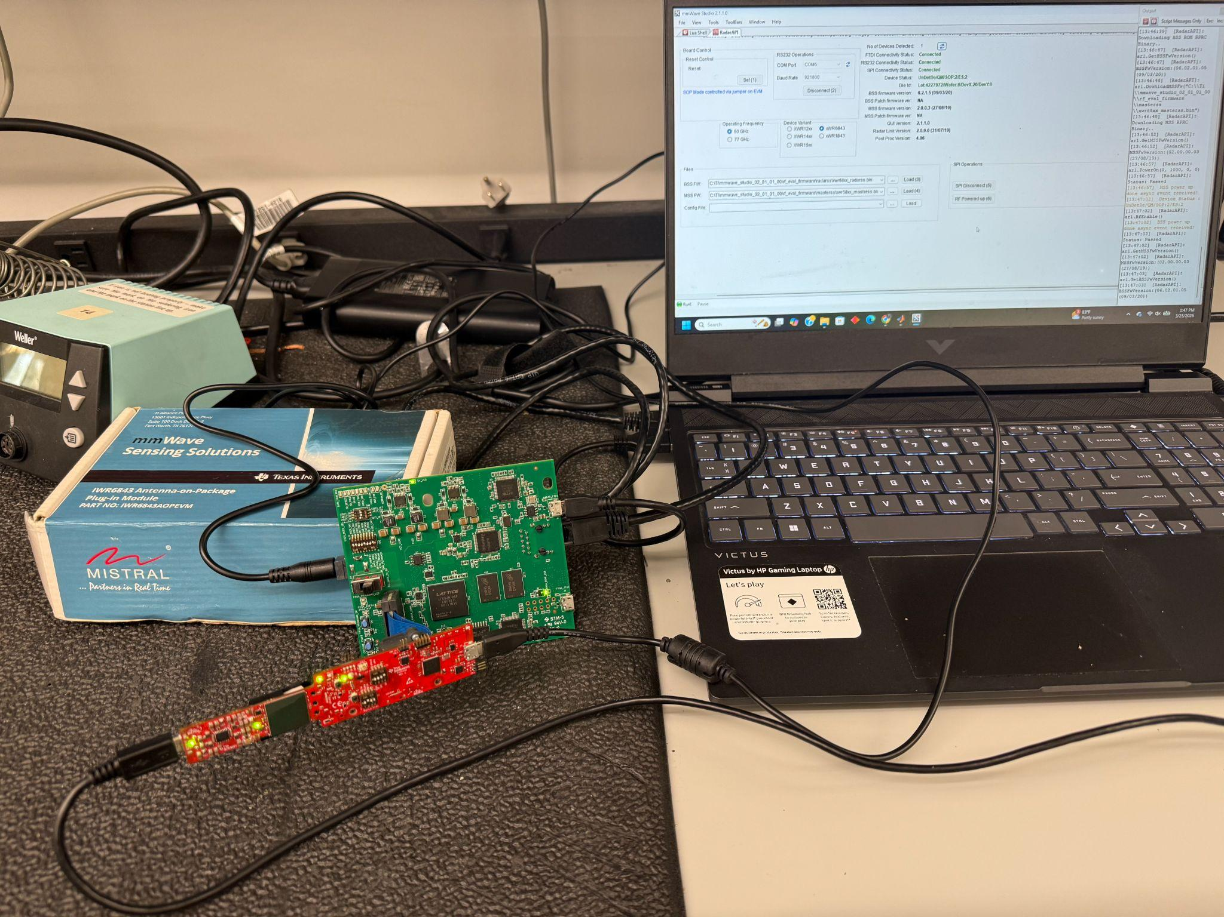
Integrated System Diagram
Hardware

Slide 5
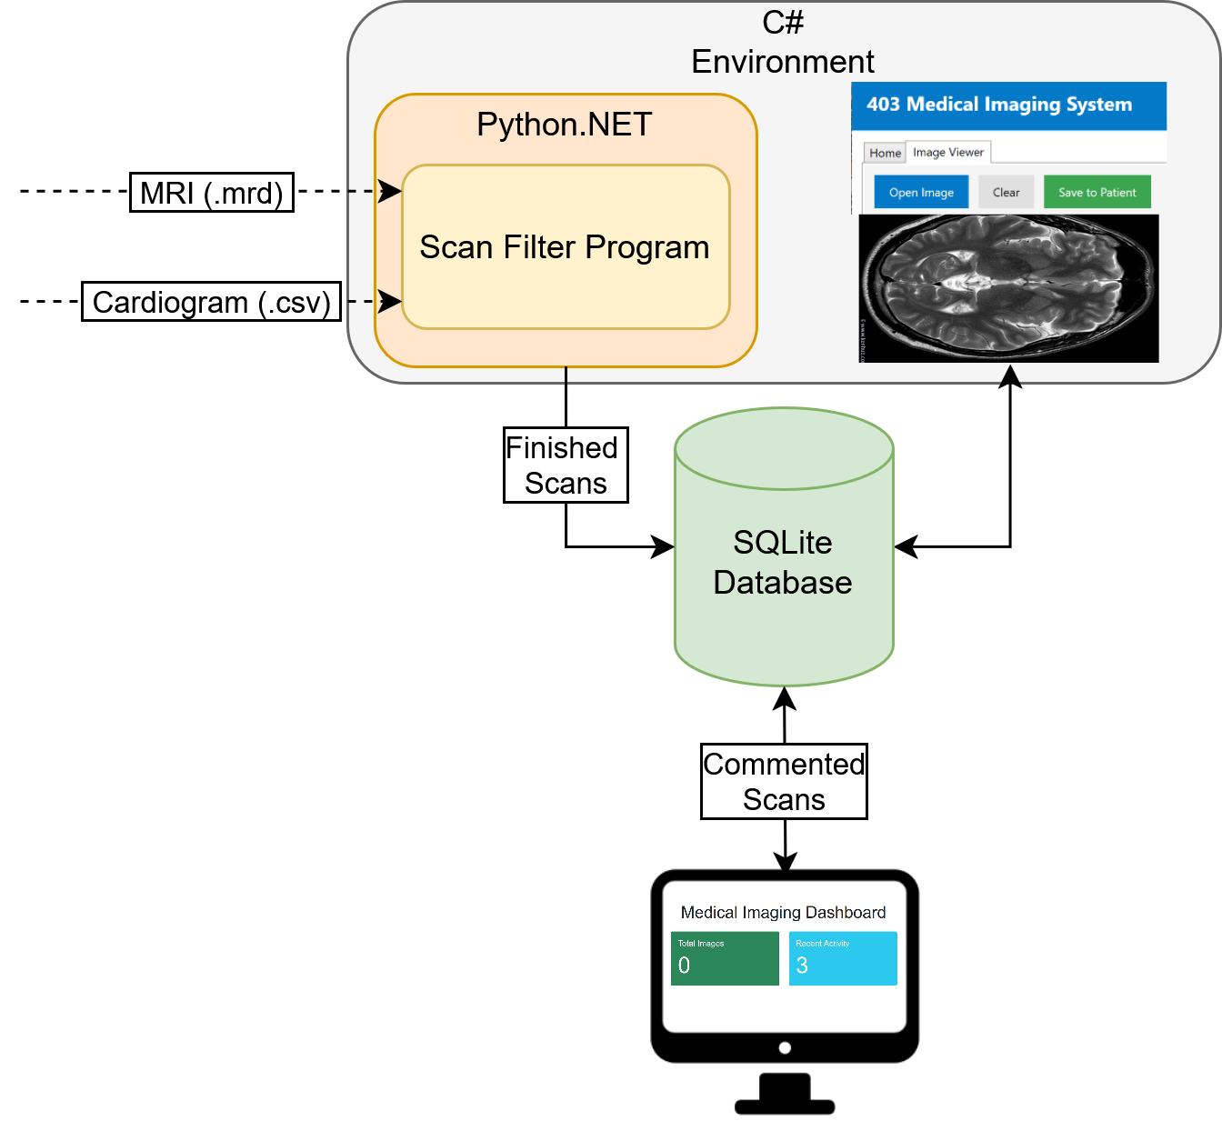
Integrated System Diagram
Software

Slide 6
Project Timeline
Subsystem Designs and Testing (completed 2/2) | PCB Ordered (completed 2/4) | MCU and PCB Functionality Tests (2/26) | Radar & Data Capture Card Integrated (03/04) | MCU and PCB Deployable (to complete by 3/16) | Integration of Scan Filter and MRI (to complete by 3/16) | Integration of Scan Filter and Desktop Application (to complete by 3/16) | System Testing (to complete by 3/30) | Validation (to complete by 4/6) | Demo and Report (to complete by 4/19)
Notes:
Eric

Slide 7
PCB Andrew-Joseph Nicolas
Accomplishments since last update 20 hrs of effort | Ongoing progress/problems and plans until the next presentation
PCB design fully functional Validation between hardware being procedurally completed | Finish load testing 2 of the DC rails Confirm communication over UART with MCU Confirm supporting hardware powers on from PCB

Slide 8
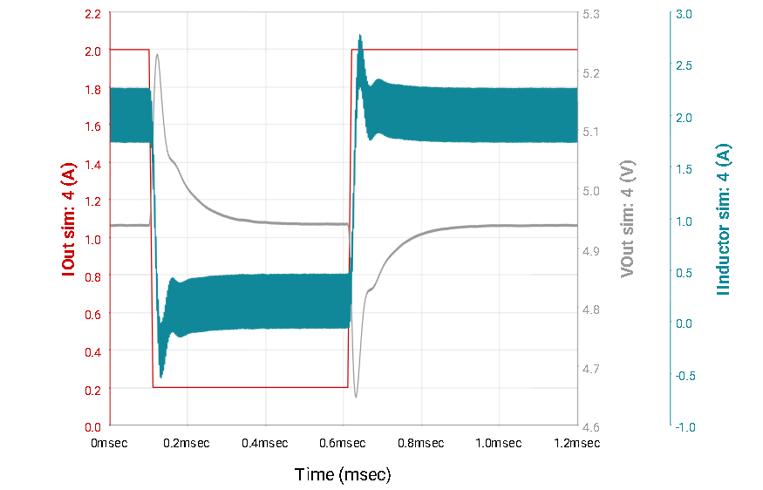
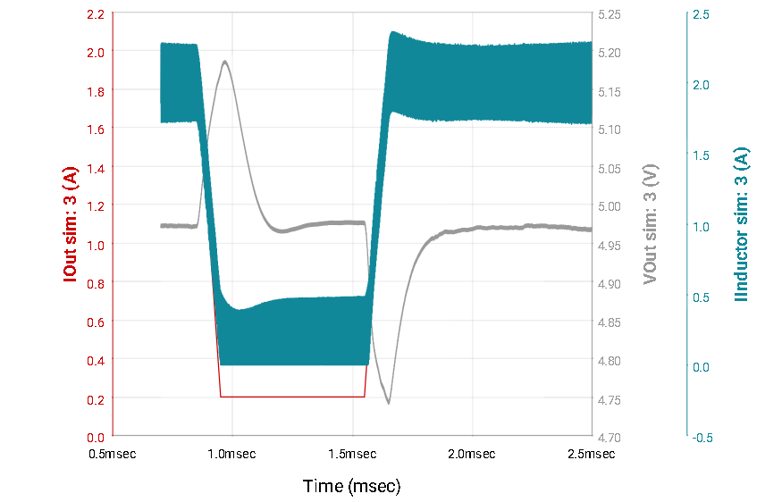
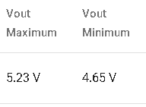
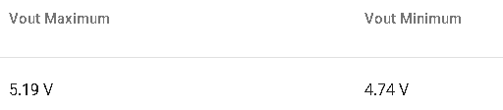
PCB Andrew-Joseph Nicolas
5V @ 3A Rail Simulation (DCA)
5V @ 2A Rail Simulation (Radar)

Slide 9
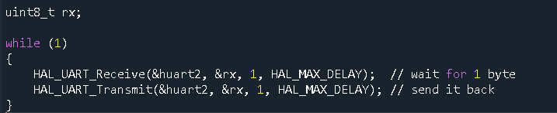
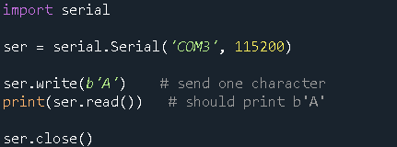
MCU Communication Validation
Andrew-Joseph Nicolas
MCU Side (C)
PC Side (Python)
Send byte from host PC over appropriate COM port into RX pin of MCU
MCU reads and transmits the same byte over its TX pin
If working correctly, Python terminal should show the received byte.

Slide 10
Radar Verification Lance Pagaduan
Accomplishments since last update 14 hrs of effort | Ongoing progress/problems and plans until the next presentation
Radar configured to match vital signs demo settings Raw I/Q data extracted from radar to data capture card Post processing of I/Q data Validated I/Q sampling range bin matches vital signs demo | Ongoing verification of data coming from chest region Ongoing verification of MCU code with I/Q data

Slide 11

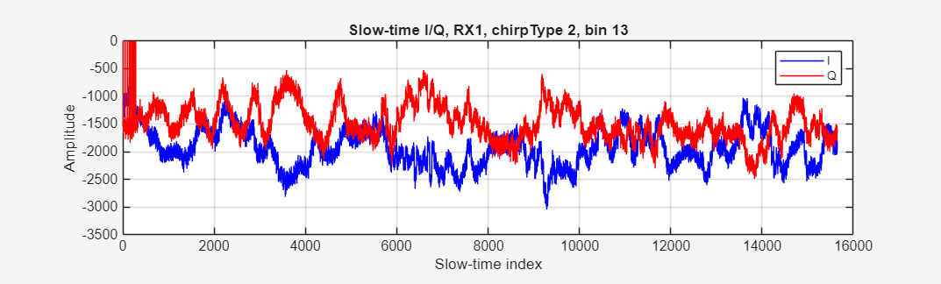
Radar Verification Lance Pagaduan

Slide 12

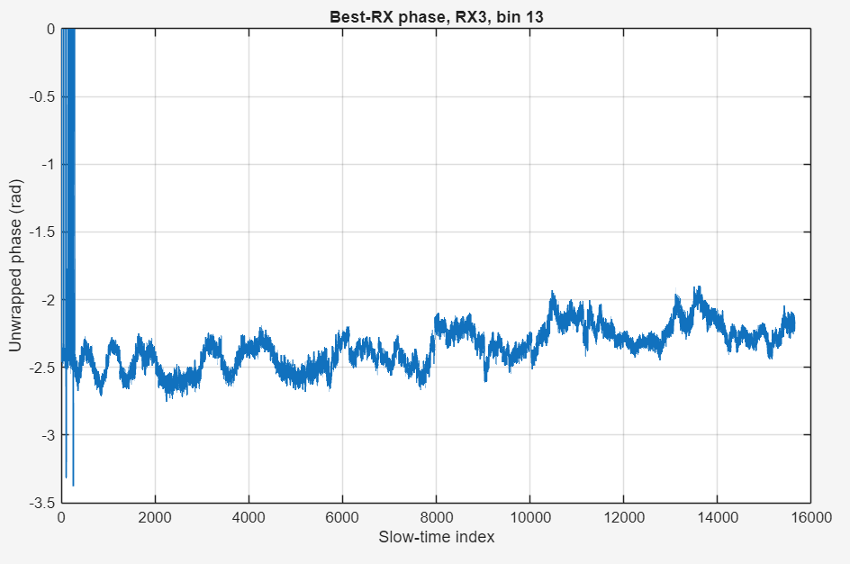
Radar Verification Lance Pagaduan

Slide 13
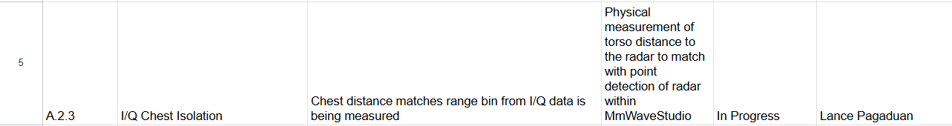
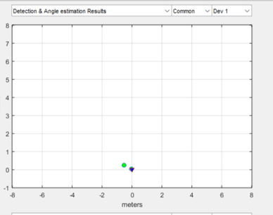
Radar Verification Lance Pagaduan

Slide 14
Scan Filter Harin Sankar
Accomplishments since last update 13 hrs of effort | Ongoing progress/problems and plans until the next presentation
Integration Testing of the MRI and cardiogram pipeline for data ingest, synchronization, and cardiac binning. System validation for motion corruption, invalid cardiogram input, and cardiogram outliers. | Complete and document validation results for timing accuracy, motion rejection, and fault handling. System Validation of MCU-Scan Filter Integration

Slide 15
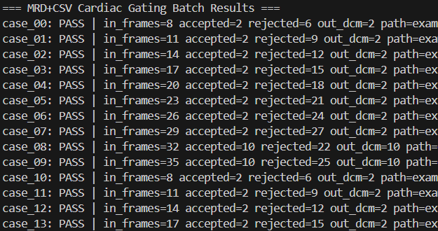
Scan Filter
Harin Sankar
Batch Validation

Slide 16
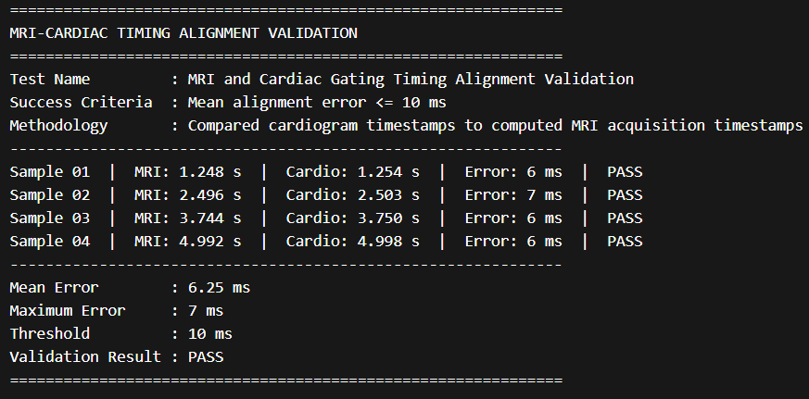
Scan Filter Harin Sankar
Synchronization Validation

Slide 17
User Interface Simon Becker
Accomplishments since last update 8 hrs of effort | Ongoing progress/problems and plans until the next presentation
Test bench verification of critical Python.NET functions Foundational scan filter code wrapped | Python package bugfixes Scenario testing of MRI data input to image viewer

Slide 18
User Interface
Simon Becker
Python.NET Scan Filter:
Loads EXAMPLE DICOM and Cardiogram Data
Aligns timetables
Detects cardiac cycles
Filters acceptable frames
To Be Tested:
Take MRI input values
Take cardiogram inputs from radar

Slide 19
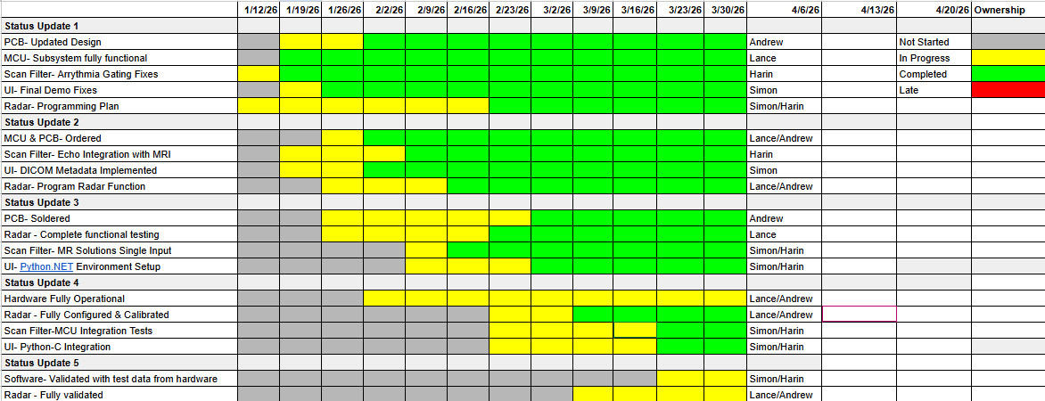
Execution Plan

Slide 20
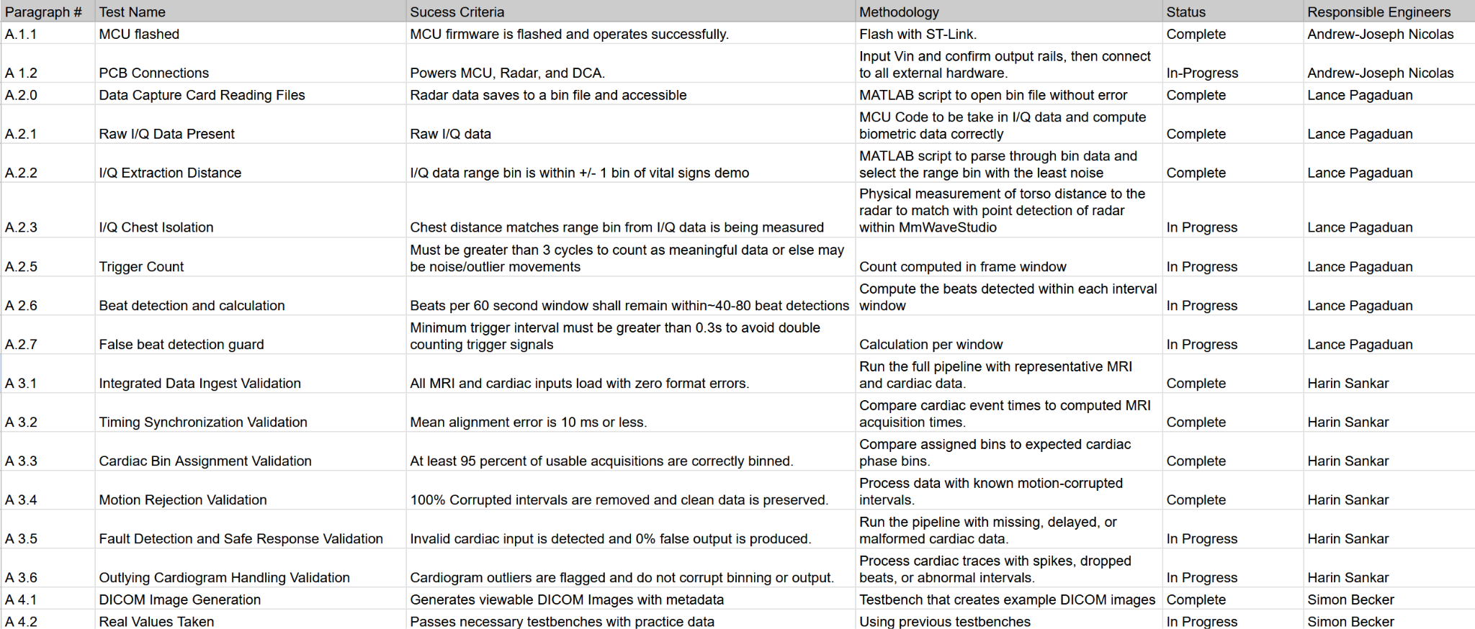
SYSTEM Validation Plan

Slide 21
Thank You

